Slide 1


Operating model for mobility
ITP Project for City of Espoo
30.8.2022
Team Screaming Jets
Halén, Leevi
Khanal, Shradha
Niemi, Tytti
Peterson, Colin
Rueda, Mateo

Slide 2






Team background
Project brief
Methods & tools
Agenda
Q&A
Summary
Operating model
Notes:
Pictures: Pixabay

Slide 3



Information Technology Program (ITP)
Team background
Aalto University summer minor program (24 ECTS) that brings together students from diverse backgrounds to solve digital business problems. ITP enables students to combine business, design, and technological perspectives and prepares them for a future of data-driven and evidence-based decision making in the digital economy.
During the three-month-long program, students gain valuable project work experience in international multi-disciplinary teams. Collaboration with a company client on a real-life project helps students expand their network and apply the skills they learn in a meaningful way.
https://www.aalto.fi/en/school-of-business/information-technology-program-itp
Notes:
Illustration: Icons8

Slide 4

Meet the team
Team background
Shradha Khanal
Operations managerShradha Khanal
Operations manager
Colin Peterson
Project Manager
Lead and facilitate ideation and execution of project deliverables
BBA, MIS & Strategic Analysis Simon Fraser University (2019-Present)
Shradha Khanal​
Communications Expert
Ensure effective communication between the team and Espoo
BScBA, International Business, Aalto University (2020-)
Mateo Rueda​
Researcher
Research and development
BSc. Biomedical Engineering (2015-2020)
MSc. ML, Data Science and AI, Aalto University (2021-)
Leevi Halén​
Data analyst
Overall data gathering and supporting tasks
BScBA, International Business, Aalto University (2017-2020)
MSc, ISM, Aalto University (2020-)
Tytti Niemi​
Design
Service design activities, facilitation
M. Sc. Electrical Engineering & Energy Technology, University of Vaasa (2018)
Bachelor of Arts, Design, Aalto University (2020-)
Notes:
The roles and responsibilities of all team members within the project

Slide 5


Project brief
Project brief
Objectives
The city of Espoo is working for a more fair and open data sharing strategy. The goal for this project is to gather understanding about routines, regulations and legislation of data sharing and Espoo’s role in the data sharing ecosystem. The emphasis is on the understanding of the current state, future changes in e.g., EU regulation and creation of guide for operation. The investigation includes:
Espoo’s role in the process, current responsibilities
Current data sharing activities regarding mobility, its stakeholders, pain points & physical evidences
A decision of a use case
Stakeholder understanding
Notes:
Illustrations: Icons8

Slide 6


Research questions
Project brief
What is the potential utility of sharing data from other transport services and the benefit for Espoo?
What are the challenges of data privacy and value for the end users?
How can public and private players make data creation, sharing and utilization easier?
Supporting data
creation
and utilization
Coordinating
collaboration
Managing
the masterdata
Notes:
Illustration: City of Espoo
When we started the project, one of the first things we did was the definition of our research questions, as none of us was familiar with the topic before. We clustered the questions around three themes: supporting data creation and utilization, coordinating collaboration and managing the masterdata. More precisely, we started to study how can public and private players make data creation, sharing and utilization easire, what is the potential utility of sharign data from other transport services and the benefit for Espoo, and what are the challenges of data privacy and value for the end users. During our project, we steered more towards the first two questions, as it seemed that for example the technical challenges of managing the masterdata are out of scope within this given timeline. Still, we did gain a few insights regarding the privacy etc. But let’s take a look how we structured our research.

Slide 7






Human-centered design (HCD) process
Methods & tools
The process is iterative and aims to involve stakeholders in each step.
Understanding
Designing
Delivering
0
1
2
3
4
5
6
7
Design brief
Research
Identify customer, user and product-service system needs
Definition
Concretize the current state
Ideation
Ideate multiple solutions based on the definition
Concept design
Concretize ideas
into limited number
of concepts
Refinement
Produce the final concept
Delivery
Deliver the finished concept (operating model)
Follow-up
Implementation plan
Customer & user
involvement
Desktop research, observation, interviews
Validation with customers and users, current state workshop
Co-creation,
Insight analysis,
System analysis
Concept validation
Creation of recommendations based
on research
Concept LAB 28.6.2022
Proto LAB 8.8.2022
Life LAB 30.8.2022
1) HCD process based on IDEO’s Human-centered design process
https://www.usertesting.com/blog/how-ideo-uses-customer-insights-to-design-innovative-products-users-love

Slide 8




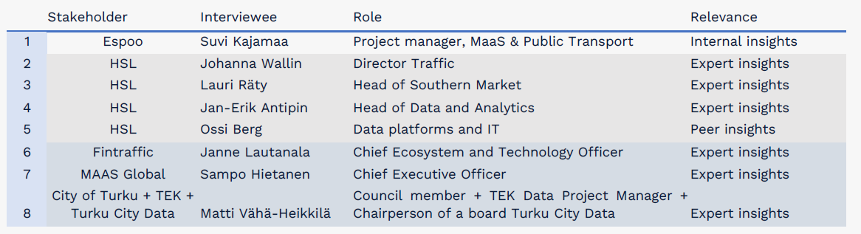
Interviews
Methods & tools
4 stakeholders
8 roles
1 live interview
1 Google Meets interview
3 Teams interviews
(Table 2. The interviewees, their organization, roles and relevance. p. 26)
Notes:
Illustration: Icons8 (2022)

Slide 9









Interview questions
Methods & tools
Introduction
Current state of data sharing in your company
The data you share and the data companies share with you
IT that supports data sharing
Legal framework or personnel you use for data sharing agreements
The ideal way to operate
Data sharing painpoints to prioritize?
Traffic Data Ecosystem (Fintraffic) benefits for the company
How could data sharing with the city of Espoo support your goals?

Slide 10
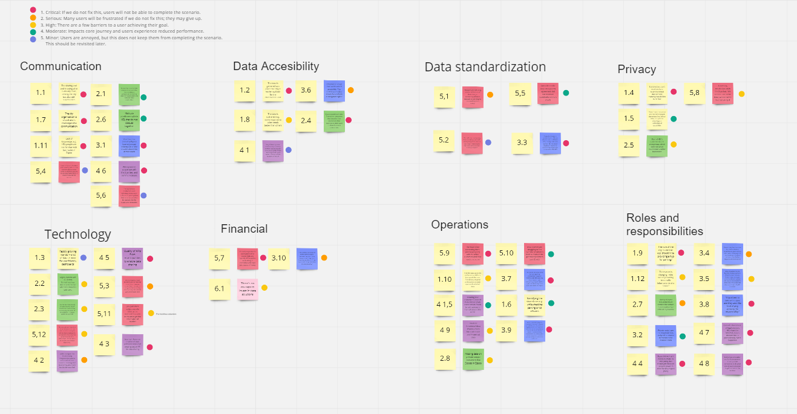
Pain point clusters
Methods & tools

Slide 11
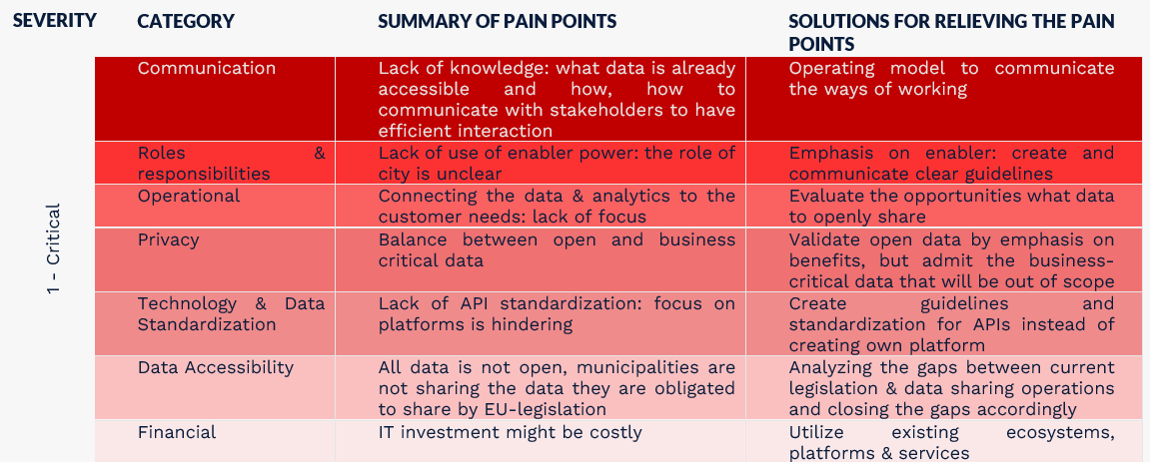
Methods & tools
Pain points: critical

Slide 12
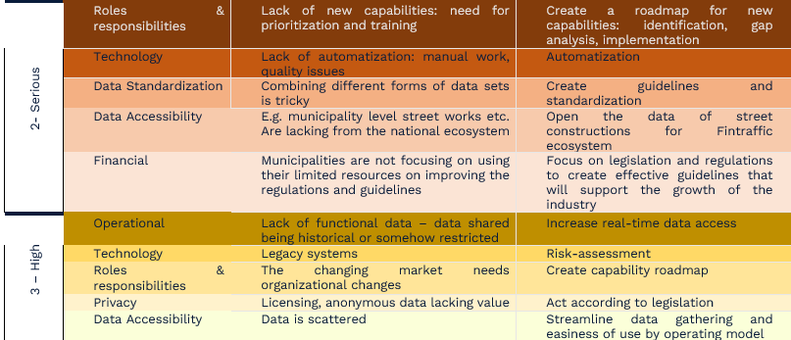
Pain points: serious & high
Methods & tools

Slide 13
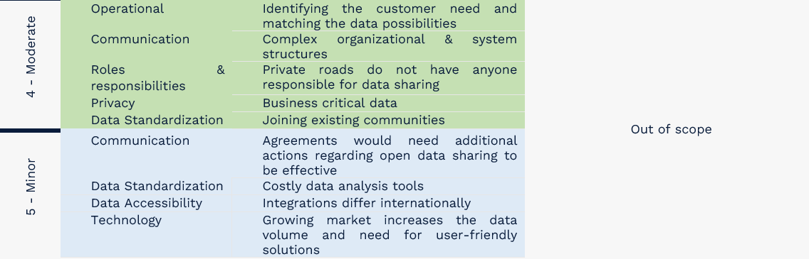
Methods & tools
Pain points: moderate & minor

Slide 14






Operating model
Operating model for mobility
Notes:
Picture: Pixabay (2022)

Slide 15


Operating model
The change will require new competencies, as co-creation method knowledge and data stewards. A capability roadmap could be created to align and prepare the organization for the future.
Espoo is aware of changing legislation – a plan for tracking actions taken to meet ITS directive deadlines would help to prioritize development. A guideline to standardized data sharing could be created and communicated.
MANAGEMENT
CAPABILITIES
OPEN
DATA SHARING
IN MOBILITY
Mapping processes and communicating them clearly helps the city and it’s stakeholders to achieve their common goals. Utilizing the role as regulator gives Espoo the power to help the standardization of the field with regulative processes.
PROCESSES
Standardized API guideline should be decided on to ensure easiness of use. The critical data points should be connected to a national access point, and the plans for closing the gaps to be defined.
DATA &
TECHNOLOGY
PEOPLE
The field of open data is full of enthusiastic and highly-skilled people – Espoo could be the force that brings them together e.g. by arranging collaborative events. Creating a communication plan for sharing existing solutions and development plans would support more effective ways of working internally & externally.

Slide 16
Espoo is aware of changing legislation – a plan for tracking actions taken to meet ITS directive deadlines would help to prioritize development. A guideline to standardized data sharing could be created and communicated.
MANAGEMENT
Operating model
The change will require new competencies, as co-creation method knowledge and data stewards. A capability roadmap could be created to align and prepare the organization for the future.
Future capabilities include
Data reuse, quality & Extract, Transform & Load (ETL)
Technical infrastructures (e.g. secure data processing environment)
Technical support (e.g. anonymization)
API standardization/Next Generation Service Interface (NGSI) framework
Change management (internally/externally)
Expectation management (internally/externally)
OPEN
DATA SHARING
IN MOBILITY
CAPABILITIES
Mapping processes and communicating them clearly helps the city and it’s stakeholders to achieve their common goals. Utilizing the role as regulator gives Espoo the power to help the standardization of the field with regulative processes.
PROCESSES
Standardized API guideline should be decided on to ensure easiness of use. The critical data points should be connected to a national data point, and the plans for closing the gaps to be defined.
PEOPLE
The field of open data is full of enthusiast and highly-skilled people – Espoo could be the force that brings them together e.g. by arranging collaborative events. Creating a communication plan for sharing existing solutions and development plans would support more effective ways of working internally & externally.
DATA &
TECHNOLOGY

Slide 17

Espoo is aware of changing legislation – a plan for tracking actions taken to meet ITS directive deadlines would help to prioritize development. A guideline to standardized data sharing could be created and communicated.
MANAGEMENT
Operating model
The change will require new competencies, as co-creation method knowledge and data stewards. A capability roadmap could be created to align and prepare the organization for the future.
Future capabilities include
Data reuse, quality & Extract, Transform & Load (ETL)
Technical infrastructures (e.g. secure data processing environment)
Technical support (e.g. anonymization)
OPEN
DATA SHARING
IN MOBILITY
CAPABILITIES
Mapping processes and communicating them clearly helps the city and it’s stakeholders to achieve their common goals. Utilizing the role as regulator gives Espoo the power to help the standardization of the field with regulative processes.
PROCESSES
Standardized API guideline should be decided on to ensure easiness of use. The critical data points should be connected to a national data point, and the plans for closing the gaps to be defined.
PEOPLE
The field of open data is full of enthusiast and highly-skilled people – Espoo could be the force that brings them together e.g. by arranging collaborative events. Creating a communication plan for sharing existing solutions and development plans would support more effective ways of working internally & externally.
DATA &
TECHNOLOGY
Notes:
From the interviews were found moderate pain points regarding matching the data available and customer needs. When data is opened, that means the volume, variety, velocity, variability, value and visualizations of data increases. To handle the increasing big data, capabilities of data stewardship should include activities like
• the creation and enforcement of policies or standards for appropriate data entry, update, and use;
• the creation and implementation of data quality control activities;
• the creation, implementation, and maintenance of business metadata (such as business rules and descriptions of tables and columns);
• other activities ensuring compliance with data governance policies.
(Jukic etc. 359)

Slide 18

Espoo is aware of changing legislation – a plan for tracking actions taken to meet ITS directive deadlines would help to prioritize development. A guideline to standardized data sharing could be created and communicated.
MANAGEMENT
Operating model
The change will require new competencies, as co-creation method knowledge and data stewards. A capability roadmap could be created to align and prepare the organization for the future.
Future capabilities include
API standardization/Next Generation Service Interface (NGSI) framework
OPEN
DATA SHARING
IN MOBILITY
CAPABILITIES
Mapping processes and communicating them clearly helps the city and it’s stakeholders to achieve their common goals. Utilizing the role as regulator gives Espoo the power to help the standardization of the field with regulative processes.
PROCESSES
Standardized API guideline should be decided on to ensure easiness of use. The critical data points should be connected to a national data point, and the plans for closing the gaps to be defined.
PEOPLE
The field of open data is full of enthusiast and highly-skilled people – Espoo could be the force that brings them together e.g. by arranging collaborative events. Creating a communication plan for sharing existing solutions and development plans would support more effective ways of working internally & externally.
DATA &
TECHNOLOGY
Notes:
From the interviews, an insight was learned that the field of open data needs a regulative entity to establish rules and guidelines for data sharing. For example for API standardization, technical capabilities would be needed to study and define the best possible solution for the required API format. The technical aspects of data management may be done by a specific role, data custodian.
Espoo can also adopt a NGSI framework for receiving data. An NGSI framework means that any data delivered to Espoo can be sent in any format if it is an OSLO defined standard (Open Standards for Local Administrations in Flanders) or a commonly used format such as MDS (cf. Infra) or GBFS (General Bikeshare Feed Specification). This framework has been adopted by the City of Antwerp in Belgium for their open data strategy (EIB, 2021).

Slide 19

Espoo is aware of changing legislation – a plan for tracking actions taken to meet ITS directive deadlines would help to prioritize development. A guideline to standardized data sharing could be created and communicated.
MANAGEMENT
Operating model
The change will require new competencies, as co-creation method knowledge and data stewards. A capability roadmap could be created to align and prepare the organization for the future.
Future capabilities include
Change management (internally/externally)
Expectation management (internally/externally)
OPEN
DATA SHARING
IN MOBILITY
CAPABILITIES
Mapping processes and communicating them clearly helps the city and it’s stakeholders to achieve their common goals. Utilizing the role as regulator gives Espoo the power to help the standardization of the field with regulative processes.
PROCESSES
Standardized API guideline should be decided on to ensure easiness of use. The critical data points should be connected to a national data point, and the plans for closing the gaps to be defined.
PEOPLE
The field of open data is full of enthusiast and highly-skilled people – Espoo could be the force that brings them together e.g. by arranging collaborative events. Creating a communication plan for sharing existing solutions and development plans would support more effective ways of working internally & externally.
DATA &
TECHNOLOGY
Notes:
The field of open data sharing is on constant movement, and the legislation is expected to be approved, implemented and improved during the next few years. Also the commercial side of open data sharing is developing. All in all, there are changing requirements for capabilities internally and externally, that need to acknowledge. For example, the changing legislation might need change management even on the operational level. Open data sharing being a collaborative field, expectations of different stakeholders is good to be listened to but also managed.

Slide 20
Operating model
The change will require new competencies, as co-creation method knowledge and data stewards. A capability roadmap could be created to align and prepare the organization for the future.
Espoo is aware of changing legislation – a plan for tracking actions taken to meet ITS directive deadlines would help to prioritize development. A guideline to standardized data sharing could be created and communicated.
MANAGEMENT
CAPABILITIES
OPEN
DATA SHARING
IN MOBILITY
Mapping processes and communicating them clearly helps the city and it’s stakeholders to achieve their common goals. Utilizing the role as regulator gives Espoo the power to help the standardization of the field with regulative processes.
PROCESSES
Standardized API guideline should be decided on to ensure easiness of use. The critical data points should be connected to a national access point, and the plans for closing the gaps to be defined.
DATA &
TECHNOLOGY
PEOPLE
The field of open data is full of enthusiast and highly-skilled people – Espoo could be the force that brings them together e.g. by arranging collaborative events. Creating a communication plan for sharing existing solutions and development plans would support more effective ways of working internally & externally.

Slide 21
The change will require new competencies, as co-creation method knowledge and data stewards. A capability roadmap could be created to align and prepare the organization for the future.
Espoo is aware of changing legislation – a plan for tracking actions taken to meet ITS directive deadlines would help to prioritize development. A guideline to standardized data sharing could be created and communicated.
CAPABILITIES
MANAGEMENT
Operating model
Mapping processes and communicating them clearly helps the city and it’s stakeholders to achieve their common goals. Utilizing the role as regulator gives Espoo the power to help the standardization of the field with regulative processes.
Future processes include
Process to ensure data accessibility to national access point (ITS directive, Data Governance Act)
Processes for pilot cases: sharing paid parking data & updating road work reporting
Process to adopt to changing legislation & updates
Process for sharing data with Espoo (guidelines & standardized APIs)
Process for data stewarding (including data quality, ETL & reuse)
OPEN
DATA SHARING
IN MOBILITY
PROCESSES
Standardized API guideline should be decided on to ensure easiness of use. The critical data points should be connected to a national data point, and the plans for closing the gaps to be defined.
The field of open data is full of enthusiast and highly-skilled people – Espoo could be the force that brings them together e.g. by arranging collaborative events. Creating a communication plan for sharing existing solutions and development plans would support more effective ways of working internally & externally.
PEOPLE
DATA &
TECHNOLOGY

Slide 22

The change will require new competencies, as co-creation method knowledge and data stewards. A capability roadmap could be created to align and prepare the organization for the future.
Espoo is aware of changing legislation – a plan for tracking actions taken to meet ITS directive deadlines would help to prioritize development. A guideline to standardized data sharing could be created and communicated.
CAPABILITIES
MANAGEMENT
Operating model
Mapping processes and communicating them clearly helps the city and it’s stakeholders to achieve their common goals. Utilizing the role as regulator gives Espoo the power to help the standardization of the field with regulative processes.
Future processes include
Process to ensure data accessibility to national access point (ITS directive, Data Governance Act)
Processes for pilot cases: sharing paid parking data & updating road work reporting
OPEN
DATA SHARING
IN MOBILITY
PROCESSES
Standardized API guideline should be decided on to ensure easiness of use. The critical data points should be connected to a national data point, and the plans for closing the gaps to be defined.
The field of open data is full of enthusiast and highly-skilled people – Espoo could be the force that brings them together e.g. by arranging collaborative events. Creating a communication plan for sharing existing solutions and development plans would support more effective ways of working internally & externally.
PEOPLE
DATA &
TECHNOLOGY
Notes:
While interviewing Fintraffic, gaps of data were discovered when discussing municipalities in general. The gaps match with the data points described in ITS directive and Data Governance Act. Even though all the legislation is still not approved nor finalized, we recommend to prepare for this data sharing by establishing a process for it. For example, pilot cases might be paid parking and/or updating and sharing the work construction information.

Slide 23

System map for data sharing future
Micro mobility providers
Data Espoo could share to enable better mobility services:
clear requirements for data sharing
Requirements &
guidelines
Availability
Data Espoo could share to increase safety & fulfill future legal requirements:
street work, traffic accidents, traffic route abnormalities
MaaS Global
Dashboards Espoo utilize
in planning
Vianova
Trimble Locus
Data Espoo could share to optimize public transport:
paid parking areas, customer flows in shopping centres
Data sharing with APIs
Parking
(not confirmed)
Real-time information about traffic & mobility
EasyPark
Espoon
Karttapalvelut
Espoo
Map Services
Pääkaupunkiseudun
Palvelukartta
Capital region
Service map
HSL interface
For open data
Reittiopas
Journey planner
Traffic data
ecosystem by
Fintraffic
Finnish
Railways
Google
TomTom
Liikennetilanne
Notes:
Currently Espoo exchanges data with Easy Parking as mentioned above, however there is one difficulty and that is that Espoo does not provide paid parking related data to interested companies like HSL that can use this data to optimize public transport.
For example, Lauri Räty, Head of Southern Market at HSL mentions that it would be important for them to obtain data on how paid parking flows in the city. Also, Fintraffic together with HSL are in a project to encourage people to use the metro instead of the private car. But for this, many people are considering parking their car near the metro to use it. To do so, it is necessary to know the parking spaces available at the metro station.
However, so far there are no APIs from the city that can access the data and share it with these stakeholders such as HSL and Fintraffic. Fintraffic could take Espoo's parking data and publish it through mass services such as Google Maps to have real-time available parking sites near the metro.

Slide 24

The change will require new competencies, as co-creation method knowledge and data stewards. A capability roadmap could be created to align and prepare the organization for the future.
Espoo is aware of changing legislation – a plan for tracking actions taken to meet ITS directive deadlines would help to prioritize development. A guideline to standardized data sharing could be created and communicated.
CAPABILITIES
MANAGEMENT
Operating model
Mapping processes and communicating them clearly helps the city and it’s stakeholders to achieve their common goals. Utilizing the role as regulator gives Espoo the power to help the standardization of the field with regulative processes.
Future processes include
Process to adopt to changing legislation & updates
Process for sharing data with Espoo (guidelines & standardized APIs)
OPEN
DATA SHARING
IN MOBILITY
PROCESSES
Standardized API guideline should be decided on to ensure easiness of use. The critical data points should be connected to a national data point, and the plans for closing the gaps to be defined.
The field of open data is full of enthusiast and highly-skilled people – Espoo could be the force that brings them together e.g. by arranging collaborative events. Creating a communication plan for sharing existing solutions and development plans would support more effective ways of working internally & externally.
PEOPLE
DATA &
TECHNOLOGY
Notes:
With all of the interviews, the changing nature of this developing field was made certain. To be adopted to the change, a process could be established for tracking and acting on the legislative updates. Also, this information could be translated into guidelines for the stakeholders sharing data with Espoo. Clear guidelines help with creating an attractive environment for data sharing pioneers. The key for easiness of use could be an internally standardized APIs.

Slide 25

The change will require new competencies, as co-creation method knowledge and data stewards. A capability roadmap could be created to align and prepare the organization for the future.
Espoo is aware of changing legislation – a plan for tracking actions taken to meet ITS directive deadlines would help to prioritize development. A guideline to standardized data sharing could be created and communicated.
CAPABILITIES
MANAGEMENT
Operating model
Mapping processes and communicating them clearly helps the city and it’s stakeholders to achieve their common goals. Utilizing the role as regulator gives Espoo the power to help the standardization of the field with regulative processes.
Future processes include
Process for data stewarding (including data quality, ETL & reuse)
OPEN
DATA SHARING
IN MOBILITY
PROCESSES
Standardized API guideline should be decided on to ensure easiness of use. The critical data points should be connected to a national data point, and the plans for closing the gaps to be defined.
The field of open data is full of enthusiast and highly-skilled people – Espoo could be the force that brings them together e.g. by arranging collaborative events. Creating a communication plan for sharing existing solutions and development plans would support more effective ways of working internally & externally.
PEOPLE
DATA &
TECHNOLOGY
Notes:
Working with increasing amount of data, data stewarding or data custodian roles need guidance. With processes for data management, data safety, quality and effectiveness are quaranteed.

Slide 26
Operating model
The change will require new competencies, as co-creation method knowledge and data stewards. A capability roadmap could be created to align and prepare the organization for the future.
Espoo is aware of changing legislation – a plan for tracking actions taken to meet ITS directive deadlines would help to prioritize development. A guideline to standardized data sharing could be created and communicated.
MANAGEMENT
CAPABILITIES
OPEN
DATA SHARING
IN MOBILITY
Mapping processes and communicating them clearly helps the city and it’s stakeholders to achieve their common goals. Utilizing the role as regulator gives Espoo the power to help the standardization of the field with regulative processes.
PROCESSES
Standardized API guideline should be decided on to ensure easiness of use. The critical data points should be connected to a national access point, and the plans for closing the gaps to be defined.
DATA &
TECHNOLOGY
PEOPLE
The field of open data is full of enthusiast and highly-skilled people – Espoo could be the force that brings them together e.g. by arranging collaborative events. Creating a communication plan for sharing existing solutions and development plans would support more effective ways of working internally & externally.

Slide 27
The change will require new competencies, as co-creation method knowledge and data stewards. A capability roadmap could be created to align and prepare the organization for the future.
MANAGEMENT
CAPABILITIES
Espoo is aware of changing legislation – a plan for tracking actions taken to meet ITS directive deadlines would help to prioritize development. A guideline to standardized data sharing could be created and communicated.
Operating model
The field of open data is full of enthusiastic and highly-skilled people – Espoo could be the force that brings them together e.g. by arranging collaborative events. Creating a communication plan for sharing existing solutions and development plans would support more effective ways of working internally & externally.
Future people include
Collaborative events
Communication plan: e.g. a newsletter for partners & stakeholders but also for internal information sharing
Training people and cocreating solutions how to keep up to date with all the data available and where to find it
OPEN
DATA SHARING
IN MOBILITY
PEOPLE
Mapping processes and communicating them clearly helps the city and it’s stakeholders to achieve their common goals. Utilizing the role as regulator gives Espoo the power to help the standardization of the field with regulative processes.
Standardized API guideline should be decided on to ensure easiness of use. The critical data points should be connected to a national data point, and the plans for closing the gaps to be defined.
PROCESSES
DATA &
TECHNOLOGY

Slide 28

The change will require new competencies, as co-creation method knowledge and data stewards. A capability roadmap could be created to align and prepare the organization for the future.
MANAGEMENT
CAPABILITIES
Espoo is aware of changing legislation – a plan for tracking actions taken to meet ITS directive deadlines would help to prioritize development. A guideline to standardized data sharing could be created and communicated.
Operating model
The field of open data is full of enthusiastic and highly-skilled people – Espoo could be the force that brings them together e.g. by arranging collaborative events. Creating a communication plan for sharing existing solutions and development plans would support more effective ways of working internally & externally.
Future people include
Collaborative events
OPEN
DATA SHARING
IN MOBILITY
PEOPLE
Mapping processes and communicating them clearly helps the city and it’s stakeholders to achieve their common goals. Utilizing the role as regulator gives Espoo the power to help the standardization of the field with regulative processes.
Standardized API guideline should be decided on to ensure easiness of use. The critical data points should be connected to a national data point, and the plans for closing the gaps to be defined.
PROCESSES
DATA &
TECHNOLOGY
Notes:
All the interviews conducted revealed the enthusiasm and motivation among the people working with open data. Espoo was seen as an important piece to this puzzle and a highly-valued partner. For example, an idea of ”open data festivals” run by Espoo was welcomed.

Slide 29

The change will require new competencies, as co-creation method knowledge and data stewards. A capability roadmap could be created to align and prepare the organization for the future.
MANAGEMENT
CAPABILITIES
Espoo is aware of changing legislation – a plan for tracking actions taken to meet ITS directive deadlines would help to prioritize development. A guideline to standardized data sharing could be created and communicated.
Operating model
The field of open data is full of enthusiastic and highly-skilled people – Espoo could be the force that brings them together e.g. by arranging collaborative events. Creating a communication plan for sharing existing solutions and development plans would support more effective ways of working internally & externally.
Future people include
Communication plan: e.g. a newsletter for partners & stakeholders but also for internal information sharing
OPEN
DATA SHARING
IN MOBILITY
PEOPLE
Mapping processes and communicating them clearly helps the city and it’s stakeholders to achieve their common goals. Utilizing the role as regulator gives Espoo the power to help the standardization of the field with regulative processes.
Standardized API guideline should be decided on to ensure easiness of use. The critical data points should be connected to a national data point, and the plans for closing the gaps to be defined.
PROCESSES
DATA &
TECHNOLOGY
Notes:
People interviewed were interested in what’s happening in Espoo. Still, some pain points regarding communication were found: it seems to be a challenge to keep up with all the information. A well put-together newsletter or dashboard could help people to find the newest information available or to know when to expect them.

Slide 30

The change will require new competencies, as co-creation method knowledge and data stewards. A capability roadmap could be created to align and prepare the organization for the future.
MANAGEMENT
CAPABILITIES
Espoo is aware of changing legislation – a plan for tracking actions taken to meet ITS directive deadlines would help to prioritize development. A guideline to standardized data sharing could be created and communicated.
Operating model
The field of open data is full of enthusiastic and highly-skilled people – Espoo could be the force that brings them together e.g. by arranging collaborative events. Creating a communication plan for sharing existing solutions and development plans would support more effective ways of working internally & externally.
Future people include
Training people and co-creating solutions how to keep up to date with all the data available and where to find it
OPEN
DATA SHARING
IN MOBILITY
PEOPLE
Mapping processes and communicating them clearly helps the city and it’s stakeholders to achieve their common goals. Utilizing the role as regulator gives Espoo the power to help the standardization of the field with regulative processes.
Standardized API guideline should be decided on to ensure easiness of use. The critical data points should be connected to a national data point, and the plans for closing the gaps to be defined.
PROCESSES
DATA &
TECHNOLOGY
Notes:
With the communication plan, what is left to do is to introduce it with training. Also, people could be engaged in finding solutions in the data jungle. Co-creation methods will help to manage and include people in the developing industry and its ways of working.

Slide 31
Operating model
The change will require new competencies, as co-creation method knowledge and data stewards. A capability roadmap could be created to align and prepare the organization for the future.
Espoo is aware of changing legislation – a plan for tracking actions taken to meet ITS directive deadlines would help to prioritize development. A guideline to standardized data sharing could be created and communicated.
MANAGEMENT
CAPABILITIES
OPEN
DATA SHARING
IN MOBILITY
Mapping processes and communicating them clearly helps the city and it’s stakeholders to achieve their common goals. Utilizing the role as regulator gives Espoo the power to help the standardization of the field with regulative processes.
PROCESSES
Standardized API guideline should be decided on to ensure easiness of use. The critical data points should be connected to a national access point, and the plans for closing the gaps to be defined.
DATA &
TECHNOLOGY
PEOPLE
The field of open data is full of enthusiast and highly-skilled people – Espoo could be the force that brings them together e.g. by arranging collaborative events. Creating a communication plan for sharing existing solutions and development plans would support more effective ways of working internally & externally.

Slide 32
Espoo is aware of changing legislation – a plan for tracking actions taken to meet ITS directive deadlines would help to prioritize development. A guideline to standardized data sharing could be created and communicated.
The change will require new competencies, as co-creation method knowledge and data stewards. A capability roadmap could be created to align and prepare the organization for the future.
MANAGEMENT
CAPABILITIES
Operating model
Standardized API guidelines should be decided on to ensure easiness of use. The critical data points should be connected to a national data point.
Future data & technology include
The state of the network
Static & dynamic traffic regulations
Safe & secure parking places for trucks and commercial vehicles
Data on detected road safety-related events or conditions
OPEN
DATA SHARING
IN MOBILITY
DATA &
TECHNOLOGY
Mapping processes and communicating them clearly helps the city and it’s stakeholders to achieve their common goals. Utilizing the role as regulator gives Espoo the power to help the standardization of the field with regulative processes.
PROCESSES
PEOPLE
The field of open data is full of enthusiast and highly-skilled people – Espoo could be the force that brings them together e.g. by arranging collaborative events. Creating a communication plan for sharing existing solutions and development plans would support more effective ways of working internally & externally.

Slide 33

Espoo is aware of changing legislation – a plan for tracking actions taken to meet ITS directive deadlines would help to prioritize development. A guideline to standardized data sharing could be created and communicated.
The change will require new competencies, as co-creation method knowledge and data stewards. A capability roadmap could be created to align and prepare the organization for the future.
MANAGEMENT
CAPABILITIES
Operating model
Standardized API guidelines should be decided on to ensure easiness of use. The critical data points should be connected to a national data point, and the plans for closing the gaps to be defined.
Future data & technology include
Data points benchmarked from Netherlands
OPEN
DATA SHARING
IN MOBILITY
DATA &
TECHNOLOGY
Mapping processes and communicating them clearly helps the city and it’s stakeholders to achieve their common goals. Utilizing the role as regulator gives Espoo the power to help the standardization of the field with regulative processes.
PROCESSES
PEOPLE
The field of open data is full of enthusiast and highly-skilled people – Espoo could be the force that brings them together e.g. by arranging collaborative events. Creating a communication plan for sharing existing solutions and development plans would support more effective ways of working internally & externally.

Slide 34

















Operating model
Planned roadworks
State highways
Current roadworks
Event dates
Incidents
Remaining duration of incidents
Dynamic parking data
Data points
of mobility
Speed limits
Static parking data
Benchmark from Netherlands
Signs
iVRI
Control scenarios from traffic centers
Cycling data
Bridge openings
Data for logistics

Slide 35
Operating model
The change will require new competencies, as co-creation method knowledge and data stewards. A capability roadmap could be created to align and prepare the organization for the future.
Espoo is aware of changing legislation – a plan for tracking actions taken to meet ITS directive deadlines would help to prioritize development. A guideline to standardized data sharing could be created and communicated.
MANAGEMENT
CAPABILITIES
OPEN
DATA SHARING
IN MOBILITY
Mapping processes and communicating them clearly helps the city and it’s stakeholders to achieve their common goals. Utilizing the role as regulator gives Espoo the power to help the standardization of the field with regulative processes.
PROCESSES
Standardized API guideline should be decided on to ensure easiness of use. The critical data points should be connected to a national access point, and the plans for closing the gaps to be defined.
DATA &
TECHNOLOGY
PEOPLE
The field of open data is full of enthusiast and highly-skilled people – Espoo could be the force that brings them together e.g. by arranging collaborative events. Creating a communication plan for sharing existing solutions and development plans would support more effective ways of working internally & externally.

Slide 36
The change will require new competencies, as co-creation method knowledge and data stewards. A capability roadmap could be created to align and prepare the organization for the future.
CAPABILITIES
Operating model
Espoo is aware of changing legislation – a plan for tracking actions taken to meet ITS directive deadlines would help to prioritize development. A guideline to standardized data sharing could be created and communicated.
Future management includes
Data management
Agreement recommendation: which data must be supplied and for which applications and reasoning what the city can use such data for
Agreement recommendation: the minimum availability, support and duration of access to the data
Stakeholder management: sharing data with service providers so they can estimate compatibility and profitability of operation
Guidelines: for example, an obligation to integrate to certain (MaaS) platforms
Study the option to externalize open data sharing (as City of Turku has done with Turku City Data)
Change management
OPEN
DATA SHARING
IN MOBILITY
MANAGEMENT
DATA &
TECHNOLOGY
Mapping processes and communicating them clearly helps the city and it’s stakeholders to achieve their common goals. Utilizing the role as regulator gives Espoo the power to help the standardization of the field with regulative processes.
PROCESSES
Standardized API guideline should be decided on to ensure easiness of use. The critical data points should be connected to a national data point, and the plans for closing the gaps to be defined.
PEOPLE
The field of open data is full of enthusiast and highly-skilled people – Espoo could be the force that brings them together e.g. by arranging collaborative events. Creating a communication plan for sharing existing solutions and development plans would support more effective ways of working internally & externally.

Slide 37

The change will require new competencies, as co-creation method knowledge and data stewards. A capability roadmap could be created to align and prepare the organization for the future.
CAPABILITIES
Operating model
Espoo is aware of changing legislation – a plan for tracking actions taken to meet ITS directive deadlines would help to prioritize development. A guideline to standardized data sharing could be created and communicated.
Future management includes
Data management
Change management
OPEN
DATA SHARING
IN MOBILITY
MANAGEMENT
DATA &
TECHNOLOGY
Mapping processes and communicating them clearly helps the city and it’s stakeholders to achieve their common goals. Utilizing the role as regulator gives Espoo the power to help the standardization of the field with regulative processes.
PROCESSES
Standardized API guideline should be decided on to ensure easiness of use. The critical data points should be connected to a national data point, and the plans for closing the gaps to be defined.
PEOPLE
The field of open data is full of enthusiast and highly-skilled people – Espoo could be the force that brings them together e.g. by arranging collaborative events. Creating a communication plan for sharing existing solutions and development plans would support more effective ways of working internally & externally.
Notes:
Given the aforementioned changing elements, need for data and change management is rising. The need is emerging both internally and externally.

Slide 38

The change will require new competencies, as co-creation method knowledge and data stewards. A capability roadmap could be created to align and prepare the organization for the future.
CAPABILITIES
Operating model
Espoo is aware of changing legislation – a plan for tracking actions taken to meet ITS directive deadlines would help to prioritize development. A guideline to standardized data sharing could be created and communicated.
Future management includes
Agreement recommendation: which data must be supplied and for which applications and reasoning what the city can use such data for
Agreement recommendation: the minimum availability, support and duration of access to the data
OPEN
DATA SHARING
IN MOBILITY
MANAGEMENT
DATA &
TECHNOLOGY
Mapping processes and communicating them clearly helps the city and it’s stakeholders to achieve their common goals. Utilizing the role as regulator gives Espoo the power to help the standardization of the field with regulative processes.
PROCESSES
Standardized API guideline should be decided on to ensure easiness of use. The critical data points should be connected to a national data point, and the plans for closing the gaps to be defined.
PEOPLE
The field of open data is full of enthusiast and highly-skilled people – Espoo could be the force that brings them together e.g. by arranging collaborative events. Creating a communication plan for sharing existing solutions and development plans would support more effective ways of working internally & externally.
Notes:
To help with future management activities, two types of agreements were benchmarked from the City of Antwerp. With the open data community, the scope and reasoning of data usage within the city, and also the availability & accessibility to this data in question should be agreed upon bilaterally.

Slide 39

The change will require new competencies, as co-creation method knowledge and data stewards. A capability roadmap could be created to align and prepare the organization for the future.
CAPABILITIES
Operating model
Espoo is aware of changing legislation – a plan for tracking actions taken to meet ITS directive deadlines would help to prioritize development. A guideline to standardized data sharing could be created and communicated.
Future management includes
Stakeholder management: sharing data with service providers so they can estimate compatibility and profitability of operation
Guidelines: for example, an obligation to integrate to certain (MaaS) platforms
OPEN
DATA SHARING
IN MOBILITY
MANAGEMENT
DATA &
TECHNOLOGY
Mapping processes and communicating them clearly helps the city and it’s stakeholders to achieve their common goals. Utilizing the role as regulator gives Espoo the power to help the standardization of the field with regulative processes.
PROCESSES
Standardized API guideline should be decided on to ensure easiness of use. The critical data points should be connected to a national data point, and the plans for closing the gaps to be defined.
PEOPLE
The field of open data is full of enthusiast and highly-skilled people – Espoo could be the force that brings them together e.g. by arranging collaborative events. Creating a communication plan for sharing existing solutions and development plans would support more effective ways of working internally & externally.

Slide 40




MANAGEMENT
OPEN DATA
The change will require new competencies, as co-creation method knowledge and data stewards. A capability roadmap could be created to align and prepare the organization for the future.
CAPABILITIES
Operating model
Espoo is aware of changing legislation – a plan for tracking actions taken to meet ITS directive deadlines would help to prioritize development. A guideline to standardized data sharing could be created and communicated.
Future management includes
Data management
Agreement recommendation: which data must be supplied and for which applications and reasoning what the city can use such data for
Agreement recommendation: the minimum availability, support and duration of access to the data
Stakeholder management: sharing data with service providers so they can estimate compatibility and profitability of operation
Guidelines: for example, an oblidation to integrate to certain (MaaS) platforms
Study the option to externalize open data sharing (as City of Turku has done with Turku City Data)
Change management
STAKEHOLDER MAP
DATA &
TECHNOLOGY
Mapping processes and communicating them clearly helps the city and it’s stakeholders to achieve their common goals. Utilizing the role as regulator gives Espoo the power to help the standardization of the field with regulative processes.
PROCESSES
Standardized API guideline should be decided on to ensure easiness of use. The critical data points should be connected to a national data point, and the plans for closing the gaps to be defined.
PEOPLE
The field of open data is full of enthusiast and highly-skilled people – Espoo could be the force that brings them together e.g. by arranging collaborative events. Creating a communication plan for sharing existing solutions and development plans would support more effective ways of working internally & externally.
FINTRAFFIC
HSL
Provides a national platform for traffic data and would be able to enrich the content with the data Espoo shares.
Provides safer and well-optimized public transportation, supported with open data
CITY OF ESPOO
OPEN
DATA SHARING
IN MOBILITY
Enables the open data sharing with clear guidelines
PARTNER
END-USER
ENABLER
MaaS GLOBAL/WHIM
MUNICIPALITIES
With more clear guidelines and structure within the field, service providers have a strong base for growth & future innovations.
With collaboration & co-creation easiness of use and well-standardized future.
SERVICE PROVIDER
CO-CREATOR

Slide 41

The change will require new competencies, as co-creation method knowledge and data stewards. A capability roadmap could be created to align and prepare the organization for the future.
CAPABILITIES
Operating model
Espoo is aware of changing legislation – a plan for tracking actions taken to meet ITS directive deadlines would help to prioritize development. A guideline to standardized data sharing could be created and communicated.
Future management includes
Study the option to externalize open data sharing (as City of Turku has done with Turku City Data)
OPEN
DATA SHARING
IN MOBILITY
MANAGEMENT
DATA &
TECHNOLOGY
Mapping processes and communicating them clearly helps the city and it’s stakeholders to achieve their common goals. Utilizing the role as regulator gives Espoo the power to help the standardization of the field with regulative processes.
PROCESSES
Standardized API guideline should be decided on to ensure easiness of use. The critical data points should be connected to a national data point, and the plans for closing the gaps to be defined.
PEOPLE
The field of open data is full of enthusiast and highly-skilled people – Espoo could be the force that brings them together e.g. by arranging collaborative events. Creating a communication plan for sharing existing solutions and development plans would support more effective ways of working internally & externally.
Notes:
City of Turku has founded an external company, Turku City Data, to run the open data sharing.

Slide 42
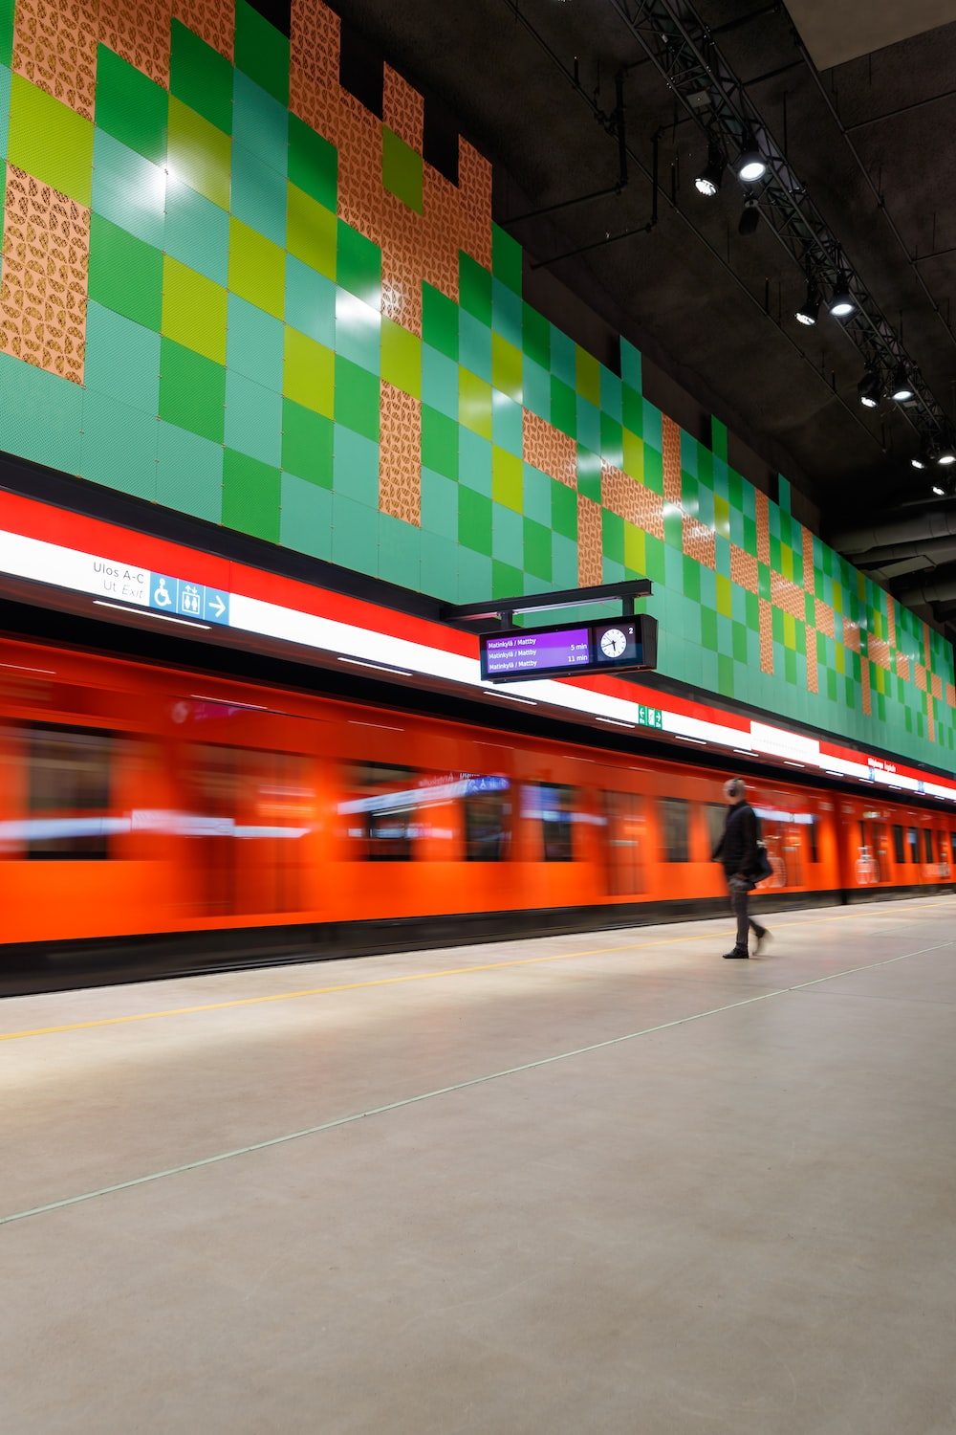


Summary
Understanding
Designing
Delivering
Legislation: ITS directive, European Data Strategy, Data Governance Act (DGA), Rulebook for a fair data economy​
Benchmarking: City Data Exchange – Lessons learned from a public/private data collaboration (Municipality of Copenhagen 2018), Netherlands – Data Top 15 ​
Tools: RACI matrix, GAP Analysis, Operating model, pain point analysis System map, clustered pain point analysis
Methods: Workshop, interviews
Recommendations:
Keeping up to date current and upcoming legislation in the field of mobility
Collaboration and communication
Managing change and capability roadmap
Operating model:
Capabilities, Processes, People,
Data & technology, Management
Notes:
Picture: Unsplash(2022)

Slide 43
Q&A
Understanding
Designing
Delivering
Thank you!
For report enquiries, please contact Wilhelmiina Griep wilhelmiina.griep@espoo.fi
Legislation: ITS directive, European Data Strategy, Data Governance Act (DGA), Rulebook for a fair data economy​
Benchmarking: City Data Exchange – Lessons learned from a public/private data collaboration (Municipality of Copenhagen 2018), Netherlands – Data Top 15 ​
Tools: RACI matrix, GAP Analysis, Operating model, pain point analysis System map, clustered pain point analysis
Methods: Workshop, interviews
Recommendations:
Keeping up to date current and upcoming legislation in the field of mobility
Collaboration and communication
Managing change and capability roadmap
Operating model:
Capabilities, Processes, People,
Data & technology, Management
Notes:
Picture: Unsplash(2022)

